Slide 1


Subject: “Instrumentation” Lecture 1 (Introduction) ganeshpa@nec.edu.np ganeshadhikarireal@gmail.com
Instrumentation

Slide 2

Instrumentation
Text Books: 1. “A text book of Instrumentation and Measurement Techniques”. By Ganesh Adhikari. 2. “Modern Electronic Instrumentation and Measurement Techniques”. By A.D. Helfrick and W.D. Cooper. 3. “Electrical and Electronics Measurements and
Instrumentation”. By A.K. Sawhney. 4. “Electrical and Electronics Measurements and
Instrumentation”. By J.B. Gupta.

Slide 3
Instrumentation
Course Contents:
Introduction to Instrumentation System.
Signal Measurements.
Physical Variables and Transducers.
Signal Conditioning and Processing.
Data Transmission.
Output Devices.
Data Acquisition Systems.

Slide 4
Introduction to instrumentation
Instrument
Device for determining the magnitude of a quantity or variables.
Physical means of determining quantities or variables.
Instrument Types:
Mechanical instruments.
Electrical instruments.
Electronics instruments.

Slide 5

Introduction to instrumentation
1. Mechanical Instruments:
Very reliable for static and stable conditions.
Unable to respond rapidly for dynamic and transient conditions.
Instrument moving part is rigid, heavy, bulky & have large mass etc.
It causes obstacle to rapid change in dynamic conditions.
Mechanical instruments creates noise pollution.

Slide 6


Instrument types
2. Electrical Instruments
Comparatively rapid than mechanical method.
Normally, electrical system depends upon mechanical system which has some inertia.
Therefore, electrical instruments have limited time response.
Electronic Instruments
In electronic device, the only movement involved is that of electrons.
Since electrons have very small inertia, the response time becomes very fast. (eg. CRO yields response in ns)
In general electronics have: i) Higher sensitivity ii) Faster response iii) Greater flexibility iv) Small in size & less in weight v) Lower power consumption vi) Higher reliability etc.

Slide 7


Classification of instruments
Classified as
Absolute Instruments
Secondary Instruments
Absolute Instruments
Provide the magnitude of quantity under measurement in terms of physical constants of instrument.
eg. Tangent galvanometer, Rayleigh’s current balance.
2. Secondary Instruments
It is so designed that the quantity being measured can be measured by observing the output indicated by instrument.
It is calibrated by comparison with an absolute instrument or secondary instrument which already calibrated against absolute instruments.
eg. A voltmeter, A glass thermometer, & A pressure gauge etc.

Slide 8
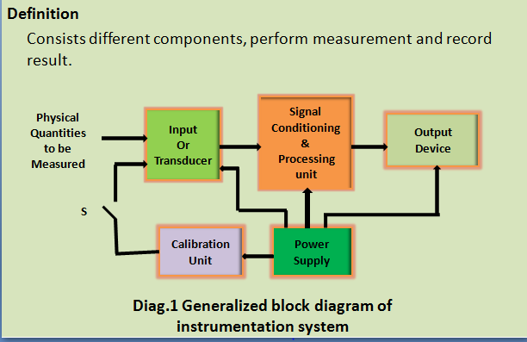
Instrumentation System

Slide 9

Instrumentation System
Input
Quantity
to be
measured
Signal
Conditioner
Variable
Conversion
element
Primary
Sensing element
Transducer
Data
Presentation
element
Data
Transmission
element
Variable
Manipulation
element
Diag.2 Generalized block diagram of instrumentation system.

Slide 10
Instrumentation System
Primary Sensing Element:
Measurand make its first contact with primary sensing element.
Measurand is first detected by Primary sensor.
Variable conversion Element:
For an instrument to perform desired function, it becomes necessary to convert output to some other form; while preserving the information content of original signal. eg ADC.
Variable Manipulation Element:
It manipulate the signal presented to it, while preserving original nature of signal.
It just deals with change in numerical value of signal.
Eg. Voltage Amplifier.

Slide 11
Instrumentation System
Data Transmission Element:
Instrumentation System components are physically separated.
It becomes necessary to transmit data from one to another.
The element that perform this function is called data transmission element.
eg. Control signal sent from station to space craft via telemetry system using radio waves.
Data Presentation Element:
It includes final stage of instrumentation system.
It converts the information about quantity under measurement.
The choice of output device depends on how one want the signal to be presented at output.

Slide 12

Instrumentation types
Classified as
Intelligent instrumentation
II. Dumb instrumentation
Intelligent instrumentation
Once measurement performed the further processing of data carried out to refine the data by the instrument itself.
Dumb instrumentation
Once measurement performed, the further processing of the data carried out by the observer himself or herself.
Physical variables
Suitable transducers are used for the measurement of physical variables.
Variable capacitance pressure gauge.
Piezo-electric pickup.

Slide 13
Physical variables
Physical variables
Thermocouple.
Resistance thermometer (RTD).
Thermistor.
Photo-voltaic cell.
Photo emissive cell.
Hall-effect pick-up.
Strain gauge, etc.

Slide 14
Signal
Definition
Variation of any physical quantity with time.
Classifications
Analog & Digital signal
Deterministic & Non-deterministic signal
i) Analog signal
Signal continuous in nature and any value in limited range implies meaning.
f(t)
t
ii) Digital signal
Signal discrete in nature and deals with only two values i.e. logic o & logic 1.
Any value in the limited range does not implies any meaning.

Slide 15

Signal
f(t)
1 1
0 0 t
iii) Deterministic signal
Signal can be represented by explicit mathematical function of time.
Types
Periodic signal
Aperiodic signal
Periodic signal
Signal has uniform waveform that repeats itself at regular interval of time.
f(t)
0
t

Slide 16
Signal
b) Aperiodic signal
Signal that occurs only once and exits for certain duration of time.
f(t)
0
t
Non-deterministic signal
Signal that could not be described by explicit mathematical function of time.
Such signal could not be predicted.
Random signals analyzed by using probability theory and statistical techniques.
f(t)
0
t

Slide 17
Measurements
Definition
It is the process by which one can convert physical quantity to meaningful numbers.
Concern terms
Accuracy
Precision
Sensitivity
Resolution
Measurement methods
Direct Measurement
Indirect Measurement

Slide 18
Error
Definition
It is the deviation from the true value of the measured variables.
Classification
Gross Error
Systematic Error
Random Error
1. Gross Errors
It occurs due to Human mistake in reading or using instruments and in calculating results.
Some important causes are:
Misreading of instruments. eg.- Parallax ( Apparent difference in position).
Incorrect adjustment. eg.- Zero adjustment.
Improper application. eg.- Less sensitive galvanometer used to measure small current.
Computational mistake. eg.- Rounding number before multiplying etc.

Slide 19
Errors
Remedies:
One must have proper knowledge of instrument.
One must have proper measuring habits.
One must be very careful & attentive at the time performing measurements.
One must use two or more users to take critical data.
2. Systematic Errors
It occurs due to short coming of the instruments, such as worn parts, environment effects on instrument or user.
Classification
Instrumental Error
Environmental Error

Slide 20
Errors
I) Instrumental Errors
Caused due to Mechanical structure of instrument
Caused due to short coming of instrument eg.-such as
Friction in bearing
Stretching of spring
Worn parts
Wrong calibration
Overloading of instruments, etc.
Remedies
Selecting appropriate instrument for particular application.
Using correction factor
Calibrating instrument against standard.
Adopt more than one technique to measure parameters, etc.

Slide 21
Errors
II. Environmental Error
Caused due to change in environmental conditions, such as change in Temperature, Pressure, Humidity, Electrostatic or Magnetic field, etc.
Remedies
Perform measurement under ideal environmental conditions.
Use Electrostatic and Magnetic shielding.
Adopt policy of new calibration in new condition.
Use instrument that not get effected much by environmental change.
Use Hermitically seal equipments.
Adopt policy of applying appropriate techniques.
Random Error
It occur due to unknown causes or due to causes which becomes very difficult to find out.
It occur even when all systematic errors are avoided.
It’s small in magnitude, neglected for general measurement purpose.
But for high accuracy work, it must considered.

Slide 22
Errors
Remedies
It could be minimized using statistical approach, such as
Mean
Deviation from Mean
Average Deviation
Standard Deviation
Variance
Mean
Let x1, x2, x3, --------xn are first, second, third, ------ nth reading from measurement, then
arithmetic mean is given by
ˉ = [{x1+x2+---------+xn}/n] = [εx/n] -------- (1)
Deviation from Mean
It is departure of given reading from mean.
d1 = x1 – x’
d2 = x2 – x’
-
-
dn = xn – x’.
x

Slide 23


Errors
iii) Average Deviation
It is the sum of absolute values of deviations divided by number of readings.
D = [ { |d1|+|d2|+ ---- +|dn|} / n ]
= [{ε|d|}/n] ------ (2)
iv) Standard Deviation
For n →∞, It is the square root of sum of all individual deviations squared, divided by number of readings.
σ = [{(d1)² + (d2)² + ----- +(dn)²} / n ] ^{1/2}
σ = √[∑(dt)²/n] ------ (3)
For n → finite number of observations.
σ = [{(d1)² + (d2)² + ----- +(dn)²} / (n-1) ] ^{1/2}
σ = √[∑(dt)²/(n-1)] ------ (4)

Slide 24
Errors
v) Variance
It is the square of the standard deviation.
V = σ² [ Mean square deviation] ------ (5)
Gaussian Distribution of Errors
19
Number 12 10
of
observed
Reading 4 3
1 1
99.7 99.8 99.9 100 100.1 100.2 100.3 Volts

Slide 25
Gaussian Distribution of Error
To understand the concept, the experiment performed to measure voltage at certain interval of time.
The nominal value of the measured voltage was 100V, measured at 50 times.
From experiment, it observed that most of the readings are close to the actual value.
Only few readings deviate much from actual value.
Tabulation of voltage reading
S.NO. | Voltage | Reading
1 | 99.7 | 1
2 | 99.8 | 4
3 | 99.9 | 12
4 | 100 | 19
5 | 100.1 | 10
6 | 100.2 | 3
7 | 100.3 | 1

Slide 26
Gaussian Distribution of Errors
The bell shaped curve is known as a Gaussian curve.
Gaussian curve give rise to Gaussian law of errors as
Most observations include small disturbing effects called random Errors.
Random errors can be positive or negative.
There is an equal probability of positive and negative Random errors.
occurrence
- Error
+ Error
-3σ
-2σ
-1σ
-r +r
+1σ
+2σ
+3σ

Slide 27
Gaussian’s distribution of Errors
As measurement includes both plus and minus Errors, the total error becomes very small and mean value becomes true value of measured variable.
The possible Error distribution curve stated as:
Large Errors are very improbable.
Small Errors are more probable than large Errors.
There is an equal probability of plus and minus Errors so that probability Error become about zero value.
Probable Error
The entire observations lies between + (∞) and – (∞) as shown in diagram.
Area under probability curve
Deviation ± ʃ σ | Fraction of total area includes
o.6745 | 0.5000
1.0 | 0.6828
2.0 | 0.9546
3.0 | 0.9972

Slide 28


Probable Error
The convenient measure of precision is the quantity ‘r’.
The quantity ‘r’ is termed as probable error.
Limiting Error
It is a limit of deviation from specified values.
Circuit components are guaranteed within a certain percentage of their rated value.
eg. R = 1ooΩ ± 5 %
It means that the value of resistance falls between the limits 95Ω to 105Ω.
Similarly, A 0 to 100V voltmeter has guaranteed accuracy of 1% of full scale reading, mean that voltage fall between the limits 99V and 101V.
The voltmeter never exceed the specified limit.
r = ± 0.6745 σ

Slide 29
Bridge Measurements
Introduction
Bridge circuit is used to determine unknown electrical parameters such as Resistance, Inductance, Capacitance and Frequency etc.
The power supply used in bridge circuit may be either A.C. or D.C. Supply and thus classified as
A.C. Bridge circuit
D.C. Bridge circuit.
Detector detects signal via bridge circuit.
Galvanometer 5 Hz --- 1000 Hz.
Headphone 250 Hz --- 4 KHz.
Tunable Amplifier 10 Hz --- 100 KHz.
Conditions for Bridge balance
For no signal via detector, the EAB must require equal to be EAD.
This get happened only when EAB equals EAD in both magnitude and phase.
From diagram,
EAB = EAD
I₁Z₁ = I₂Z_{2 ----- (2.1)}

Slide 30
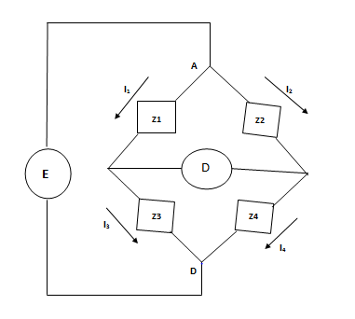
Bridge Measurements
B
D
C
Diag. 3.1 Bridge circuit

Slide 31
Condition for bridge balance
From diagram,
I₁ = I₃ = [E/(Z₁+Z₃)] ----- (2.2)
I₂ = I₄ = [E/(Z₂+Z₄)] ----- (2.3)
From eq.n (2.1)
Z₁ [E/(Z₁+Z₃)] =Z₂ [E(Z₂+Z₄)]
[Z₁/(Z₁+Z₃)] = [Z₂/Z₂+Z₄)]
Z₁Z₂+Z₁Z₄ = Z₁Z₂+Z₂Z₃
Z₁Z₄ = Z₂Z₃ ----- (2.4)
Writing in terms of admittance
Y₁Y₄ = Y₂Y₃ ----- (2.5)
Representing in terms magnitude and phase angle
Z₁LӨ₁Z₄LӨ₄ = Z₂LӨ₂Z₃LӨ₃
Z₁Z₄L(Ө₁+Ө₄) = Z₂Z₃L(Ө₂+Ө₃)
Z₁Z₄ = Z₂Z₃ ----- (2.6)
LӨ₁+LӨ₄ = LӨ₂+LӨ₃ ----- (2.7)

Slide 32
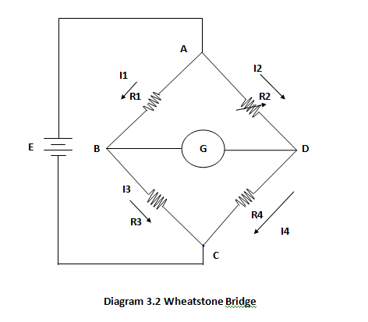
Wheatstone Bridge
Rx = ?

Slide 33
Wheatstone Bridge
It is used to measure unknown resistance value.
At balance condition,
EAB = EAD = I1R1 = I2R2. ----- (2.8)
From diagram,
I1= I3 = [E/(R1+R3)] ----- (2.9)
Similarly, I2 = I4 = [E/(R2+R4)]. ----- (2.10)
From eq.n (2.8)
[ER1/(R1+R3)] = [ER2+/(R2+R4)]
[R1/(R1+R3)] = [R2/(R2+R4)]
R1R2+R1R4 = R1R2+R2R3
R1R4 = R2R3
R4 = [(R2R3)/R1]
----- (2.11)
R3 is standard arm, and R1 & R2 are called ratio arms.
R4 = Rx = [(R2R3)/R1

Slide 34
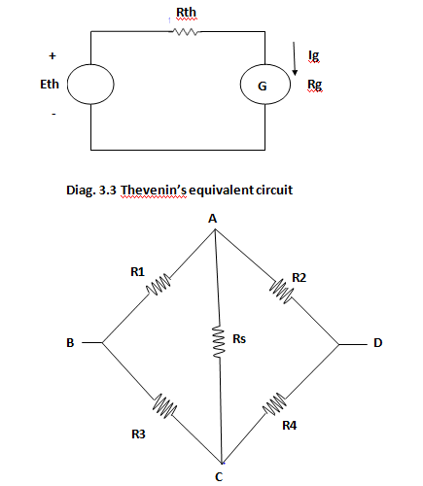
Wheatstone Bridge
Thevenin’s Equivalent Circuit
To know galvanometer required sensitivity, (in-order to detect unbalance condition) it becomes necessary to compute galvanometer current.
Ig = [Eth/(Rth+Rg)] ----- (2.12)
Let potential at B is greater than at D.

Slide 35
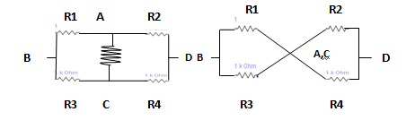
Thevenin’s equivalent circuit
Eth = EBD = EAB – EAD
= I1R1 – I2R2 = [{ER1/(R1+R3)} – {ER2/(R2+R4)}]
= E[{R1/(R1+R3)} – {R2/(R2+R4)}] ----- (2.13)
To compute Rth :
Let internal resistance of source (Rs) is very small, can be neglected.
Rth = (R1|| R3) + (R2||R4)
= [{R1R3/(R1+R3)} + {R2R4/(R2+R4)}] ----- (2.14)
Ig = [Eth/(Rth+Rg)]
Where Ig is the galvanometer current and Rg it’s resistance.
Rs

Slide 36
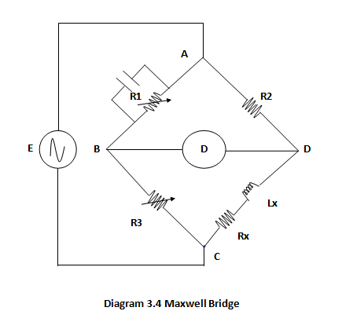
Maxwell Bridge
It is a A.C. bridge used to measure unknown inductance in terms of a known capacitance.
At balance condition
Z1Z4 = Z2Z3 ----- (2.15)
Y1 = (1/R1) + jwc1
Z2 = R2
Z3 = R3
Z4 = Rx + jwlx
From eq.n (2.15)
Z4 = Y1R2R3
Rx +jwlx = [(1/R1)+ jwc1] R2R3
Rx + jwlx = [{(R2R3)/R1} + (R2R3) JWC1]
Equating real and imaginary parts
Rx = [(R2R3)/R1] ----- (2.16)
Jwlx = (R2R3) jwc1
Lx = R2R3C1 ----- (2.17)
C1

Slide 37
Maxwell’s Bridge
The value of inductance expressed in Henry.
Advantages
Provide expression for unknown lx and Rx in terms of known bridge elements.
The frequency does not appear in any of two equations.
It is useful for inductance measurement at power and audio frequencies.
Disadvantages
This bridge is limited to measurement of low Q coils ( 1< Q < 10).
This bridge require a standard capacitor which becomes costly if calibrated to high degree of accuracy.

Slide 38
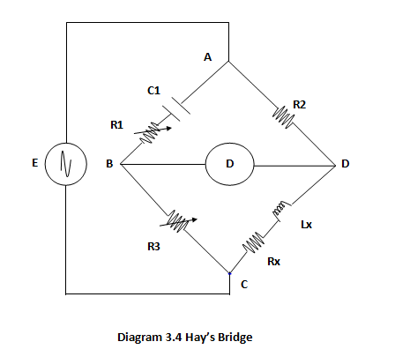
Hay’s Bridge
Hay’s bridge is appropriate for measurement of high Q-coil, i.e. Q > 10.
At balance condition
Z1Z4 =Z2Z3 ----- (2.18)
From diagram,
Z1 = {R1 +(1/jwc1)} = [R1 – {j/(wc1)}]
Z2 = R2, Z3 = R3
Z4 = [Rx + jwlx]
From eq.n (2.18)
[R1 – {j/(wc1)}] [Rx + jwlx] = R2R3
R1Rx + R1 (jwlx) – Rx [j/(wc1)] + [lx/c1] = R2R3 --- (2.19)
R1Rx + {lx/c1} + R1 (jwlx) – Rx {j/(wc1)} = R2R3 --- (2.20)
Equating real and imaginary parts of eq.n (2.20)
[R1Rx +{lx/c1}] = R2R3 ----- (2.21)
R1 (jwlx) – [Rx {j/(wc1)}] = 0
R1 (jwlx) = Rx {j/(wc1}
W²R1C1lx = Rx
Rx = w²R1C1lx ----- (2.22)
Lx = [ Rx/(w²R1C1) ----- (2.23)

Slide 39
Hay’s Bridge
Now, substituting value of Rx in eq.n (2.21) i.e. from eq.n (2.22) and (2.23)
R1 (w²R1C1lx) +{lx/C1} = R2R3
lx [w²(R1)²C1 + {1/C1}] = R2R3
lx [{(w²(R1)²(C1)² +1}/C1] = R2R3
lx =[{R2R3C1}/{1+w²(C1)²(R1)²}] ----- (2.24)
Now, once again substituting the value of lx in eq.n (2.21)
R1Rx + {Rx/(w²R1C1)}/C1 = R2R3
R1Rx +[Rx/{w²(C1)²R1} = R2R3
Rx [R1 + 1/{w²(C1)²R1}] = R2R3
Rx [{w²(C1)²(R1)² + 1}/{w²(C1)²R1}] = R2R3
Rx = [{w²(C1)²R1R2R3}/{1+w²(C1)²(R1)²}] ----- (2.25)
wlx
Z
Rx
R1
Z
ӨC
ӨL
1/(wC1)

Slide 40
Hay’s Bridge
The tangent of inductive phase angle equals
tanӨL = [XL / R] = [wLx/Rx] = Q ----- (2.26)
and that of capacitive phase angle is
tanӨc = [Xc / R] = [1/(WC1R1)] ----- (2.27)
When two phase angles are equal, their tangent also becomes equal.
tanӨL = tanӨc
Q = [1/{WR1C1}] ----- (2.28)
From eq.n (2.24)
Lx = [{R2R3C1}/{1+W²(C1)²(R1)²}]
= [{R2R3C1}/{1+(1/Q)²}]
For Q > 10, the term {1/Q}2 becomes much smaller and can be neglected. Thus above equation can reduces to
Lx = R2R3C1 ----- (2.29)
Thus, Hay’s Bridge is suitable for measurement of high Q inductors, i.e. for Q > 10.

Slide 41
Hay’s Bridge
Advantages
It provide simple expression for unknown inductance.
It provide simple expression for Q factor , i.e. Q = [1/{WR1C1}].
Disadvantages
It is only suitable for measurement of Q > 10.

Slide 42
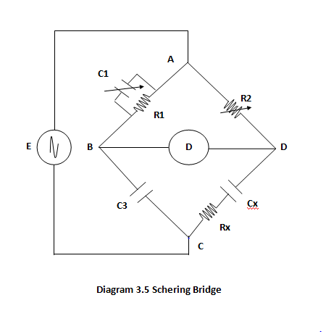
Schering Bridge
It is useful for measurement of capacitance.
It is also useful for measuring insulating properties i.e. for phase angle about 90 ͘.
The capacitor C3 is a standard capacitor, usually a high quality mica capacitor for general measurement work or an air capacitor for insulation measurements.
Mica capacitor – Low losses & phase angle 90 ͘(Appoximately).
Air capacitor – Stable value &small electric field.
At balance condition,
Z1Z4 = Z2Z3 --- (2.30)
Y1 = [ (1/R1) + (jwC1)]
Z2 = R2
Z3 = [ 1/(jwC3)] = [-j/(wC3)]
Z4 = [Rx + {1/(jwCx}] = [ Rx - { j/(wCx)}]

Slide 43
Schering Bridge
From eq.n (2.30)
[ {1/Y1} Z4] = Z2 Z3
Z4 = Y1Z2Z3 ----- (2.31)
[{Rx –J/(wCx)}] = [{1/R1} + (JwC1}] [{-J/(Wc3)}*R2]
[{Rx – j/(wCx)}] = [ {R2/R1} * {-J/(Wc3)}] + [{C1/C3} * R2] ----- (2.32)
Equating real & imaginary parts of eq.n (2.32)
Rx = [R2*{C1/C3}] ----- (2.33)
and [ - {J/(wCx)} = {R2/R1} * { -J/(Wc3)}
or [ {1/Cx}] = {R2/R1} * {1/C3}
Cx = C3 * {R1/R2} ----- (2.34)
The value of capacitance expressed in farad.
The dissipation factor of a series RC circuit is defined as
D = {Rx/Xx} = {Rx/Xc} = wCxRx ----- (2.35)
Now, substituting the value of Rx and Cx in eq.n (2.35) yields
D = wc3{R1/R2} * R2 {C1/C3}
D = wR1C1 ----- (2.36)

Slide 44
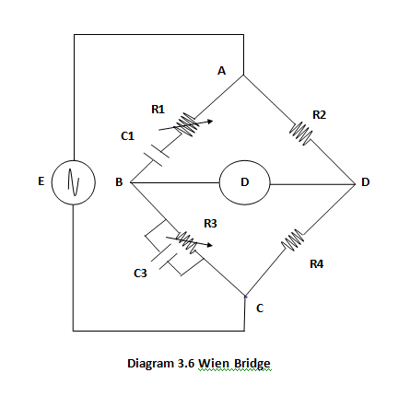
Wien Bridge
It is a A.C. Bridge use to measure unknown frequency.
It is also applicable in other useful circuits, eg.
In harmonic distortion analyzer, used as a notch filter
In Audio and HF oscillators, used as frequency determining element.
At balance condition,
Z1Z4 =Z2Z3 --- (2.37)
Z1 = [ R1 + {1/(jwC1)}] = [R1 – {J/(wC1)}]
Z2 = R2
Y3 = [ {1/R3} + (jwC3)]
Z4 = R4
From eq.n (2.37),
Z1Y3Z4 = Z2
[R1 – {J/(Wc1)}] [{1/R3} + (jwC3)] R4 = R2
{R1/R3}+R1(jwC3) – {1/R3}*{J/(Wc1} + {C3/C1} = {R2/R4}
--- (2.38)

Slide 45
Wien Bridge
Equating real and imaginary parts of eq.n (2.38)
[{R1/R3} + {C3/C1}] = {R2/R4} ----- (2.39)
and R1(jwC3) – {1/R3} * {J/wC1} = 0
R1 *jwC3 = {1/ R3} * {j/Wc1}
W²R1R3C1C3 =1
W² = {1/R1R3C1C3}
But w = 2Πf and solving for f, we get
(2Πf)² = [1/{R1R3C1C3}]
f = [ 1/{2Π√(R1R3C1C3}] ----- (2.40)
If R1=R3 & C1=C3, then eq.n (2.39) becomes
{R1/R3} + {C1/C3} = R2/R4
{R1/R1} + {C1/C1} = R2/R4
1+1 = R2/R4
R2 = 2R4 ----- (2.41)
and eq.n (2.40) reduces to
f = [ 1/{2Π√(R1R3C1C3}]
f = [{1/(2ΠRC)}] ----- (2.42)

Slide 46
Assignment
A Text Book of Instrumentation System and Measurement Techniques
By G. Adhikari
Bridge Chapter
Solve the Problems from Questions number 7 to Question number 15 (page number 76 t0 78)
Submit it by the time
Date : 8 August, 2017

Slide 47
Standards of Measurement
A physical representation of a unit of measurement is referred to as a standard of measurement.
Several standards have been developed for various units of measurement.
1. International standard
Defined by international agreement.
Maintained at international bureau of weights and measurement.
Periodically, evaluated and checked by absolute measurements in terms of fundamental units.
Not available to ordinary user for calibration and comparison purpose.
2. Primary standards
Defined by national agreement.
Kept in national laboratories of different countries of the world.
Calibrated by absolute measurements in terms of fundamental units.
Not available for use outside national lab.
Main function is the verification & calibration of secondary standard.

Slide 48
Standards of Measurement
3. Secondary standards
Maintained by particular involved industry.
Checked locally against other reference standards in the area.
Based on primary standard.
On periodic basis sent to national laboratory for calibration and comparison against primary standards.
4. Working Standards
The main tool of measurement laboratory are working standards.
Used to check and calibrate other laboratory instruments for accuracy and performance.
Also used in manufacturing components and parts.
IEEE standards
Stands for Institute of Electrical and Electronics Engineers.
Headquarter situated in Newyork city.
Not available for comparison and checking of secondary standards.
Have been adopted by many agencies and societies as standards for their organization, such as [ANSI].
Applicable for testing and evaluating various electronic system and components.
Used to specify test equipments. eg. Oscilloscope.
Concern with safety of wiring for power plants ships , industrial buildings etc.
Specify different components, schematics and logic symbols.
Specify various interfacing standards and communication standards.

Slide 49
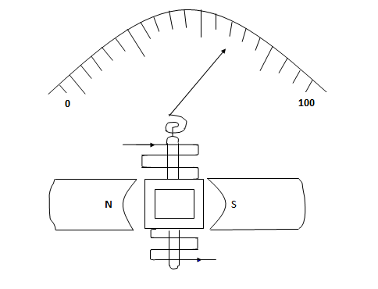
Measuring Instruments
PMMC movement is often called D’Arsonval movement.
D’Arsonval movement:
When current passed via a coil kept in permanent magnetic field, the coil moves, the direction of movement depends upon the direction of current flow and magnitude of movement depends upon the magnitude of current passed via the coil provided other parameters as constant.
Torque Equation
When current passed via coil, the deflecting Torque developed
Td ∞ I
Td = GI ----- (4.1)
Where, G = BNA
Td = deflecting torque(N-m)
B = Flux density in air gap[wb/m²
or Tesla]
I = Current in the movable coil[Ampere]
pmmc
I
Diagram 5.8 PMMC Instrument

Slide 50
PMMC
N = Turns of wire on the coil
Td = BAIN ----- (4.2)
Now, due to helical spring, there must be retarding torque in the system.
Tr ∞ Ө ----- (4.3)
Tr = KӨ ----- (4.4)
where K is spring constant.
The pointer would becomes at steady state position when Td = Tr, i.e.
GI = KӨ
I = [K/G] Ө
I ∞ Ө ----- (4.5)
[As G & K being constant]
Thus, magnitude of current via coil determines angular displacement.
Advantages of PMMC instrument
Uniform scale
Low power consumption (25µW to 200mW)
High torque weight ratio provides high accuracy.
Single instrument can be use for both current and voltage measurement.
The use of core magnet becomes very suitable in Aircraft and aerospace applications.

Slide 51
Advantages of PMMC
vi. No effect of stray magnetic field.
vii. No hysteresis loss.
Disadvantages of PMMC instrument
Not useful for A.C. measurement.
Costlier than moving iron instrument.
Error introduces due to friction, spring, temperature & magnet etc.
A PMMC instrument has dimension 35 mm * 25 mm. The flux density in air gap is 1.8*10⁻³wb/m² and spring constant is 0.14*10⁻⁶ Nm/deg. Find the number of turns required to provide an angular deflection of 90 ͘ degrees when a current of 20 mA is passed via the coil.

Slide 52
Damping
Damping
It refers to dissipation of energy due to rotation.
Absorb energy from oscillating system to bring at equilibrium position.
Galvanometer damping has two mechanisms.
Mechanical damping.
Electromagnetic damping.
Mechanical damping
Caused mainly by the motion of coil via air surrounding it.
Independent of electrical current via coil.
Friction in bearing, spring suspension, rotating coil etc. contribute to mechanical damping effects.
Electromagnetic damping
Caused by induced effect in the coil as it rotates in magnetic field.
Provided that coil forms Part of a closed electrical circuit.

Slide 53
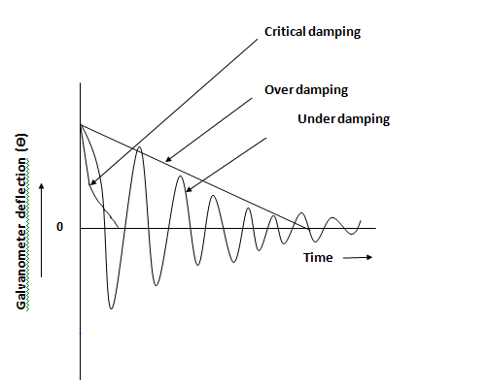
Dynamic behavior of galvanometer

Slide 54
Damping
Under damping
Coil motion subjected under sinusoidal oscillations.
Over damping
Coil returns slowly to it’s rest position without oscillations.
Pointer seems to approach the steady state position in a sluggish manner.
Critically damping
The pointer returns promptly to it’s steady state position without oscillations.
Best performance obtained when critically damped.

Slide 55
Performance parameters
Performance parameter
The functional behavior of Instrument with detailed specifications is termed as performance parameter.
It deals with limitations and capabilities of instrument for particular application.
Relates to the degree of approach to perfections.
Classified as
Static performance parameters.
Dynamic performance parameters.
Static performance parameters
The functional behavior of instrument under static conditions is termed as static performance parameters.
Accuracy
Precision
Sensitivity
Resolution
Static error
Range or Span

Slide 56
Static performance parameters
Bias
Linearity
Drift
Threshold
Dead zone
Repeatability
Reproducibility
Hysteresis
Accuracy
Closeness with which instrument reading approaches the true value of variable being measured.
Depends on the inherent limitations of instrument and short coming in the measurement process.
a) percentage of true value
Error = [{Measured value – True value} / (True value)]
b) Percentage of full scale deflection
Error = [{Measured value – True value} / (Maximum scale deflection)]

Slide 57
Static performance parameters
Precision
It is a measure of degree to which successive measurements differ from one another.
It is the measure of reproducibility of measurements.
… … …
.
. .
. .
.
. .
. .
… …
…
High precision High accuracy Poor accuracy
Poor accuracy High precision Poor precision
Diagram 5.1 Bulls eye target

Slide 58
Static performance parameters
Sensitivity
It is the ratio of output signal of instrument to change of input variables.
Sensitivity = [Output response/change in input variables]
Resolution
It is the smallest change in input variable to which instrument would just respond.
It is the smallest measurable input variables.
Static Error
It is the difference between measured value and true value of quantity.
ɗA = Am – At
Am = Measured value, At = True value of quantity.
Range or Span
The maximum and minimum value of a quantity the instrument is designed to measure.
Span = X_{max} – X_{min} .
Bias
A constant error that exists over the full range of measurement of an instrument.
By proper calibration, this error could be removed.

Slide 59
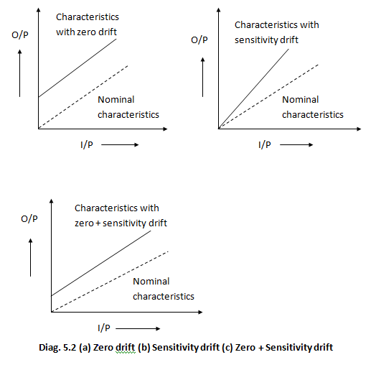
Static performance parameters
Drift
Variation in output of measuring system which is not due to any change in input quantity but due to change in operating conditions such as component instability, temperature changes etc.

Slide 60
Static performance parameters
Linearity
Output of an instrument is linearly proportional to the input quantity being measured.
Y = mx + C
where, Y = output measure, m = slope, x = variable to be measure, c = intercept on y-axis.
Threshold
Maximum value of input below which no output can be detected.
O/P
I/P
Diag. 5.3 Linear characteristics

Slide 61
Static performance parameters
Dead zone
The largest change in input quantity, over which there is no change in output value.
It occurred due to static friction, backlash or Hysteresis.
Repeatability
The closeness of output readings when same input applied repetitively over a short period of time, with same measurement conditions, same instruments and observer.
Reproducibility
The closeness with which same value of input quantity measured at different times, under different conditions by different instruments.
Hysteresis
The non-coincidence between loading and unloading curves is known as Hysteresis.
It occurred due to Friction, Backlash or Characteristics of magnetic materials.

Slide 62
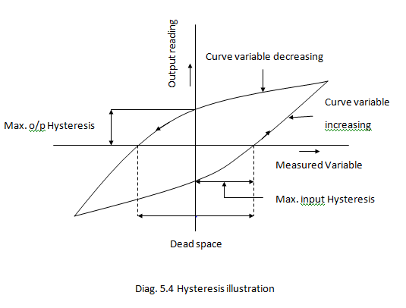
Static performance parameters

Slide 63
Dynamic performance parameters
The functional behavior of instrument under dynamic condition is referred to as dynamic performance parameters.
Speed of Response
Response Time
Measuring Lag
Fidelity
Dynamic Error
Speed of Response
It is the speed with which an instrument responds to the sudden change in the quantity to be measured.
Time taken by the system to come close to steady state condition.
Response Time
Time required by an instruments or measurement system to settle down to its steady state position after application of input.
Time taken to come to rest
Portable instrument = ± 0.3 % of final scale length.
Panel type instrument = ± 1 % of final scale length.

Slide 64
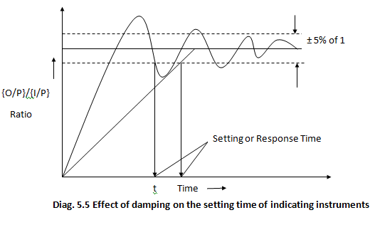
Dynamic performance parameters
Smaller settling time indicates higher speed of response.

Slide 65
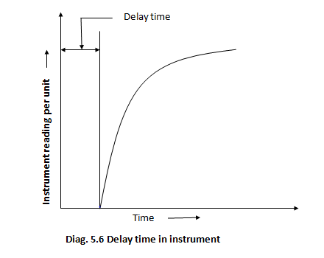
Dynamic performance parameters
Measuring Lag
It is delay in response of an instrument to change in the measurand. It is quite small in magnitude, but for high speed measurement it becomes quite significant.

Slide 66
Dynamic performance parameters
Fidelity
It is ability of an instrument or system to reproduce output in the same form as the inputs.
Output appears in the same form as the input and system becomes distortion free.
Here, any time lag, phase differences are not included.
Dynamic Error
It is the difference between true value of quantity changing with time and the value indicated by instrument under dynamic condition.
ɗA = At – Ai
where ɗA = Error
At = True value
Ai = Indicated value of quantity.

Slide 67
Transducer
Broad definition
A device which when actuated by energy in one transmission system, supplies the energy in the same form or in the another form to a second transmission system.
Transmitted energy may be in any form: Electrical, Mechanical, Chemical, Optical or Thermal etc.
Device that convert mechanical force of displacement into an electrical signal.
Classifications
Classify on the basis of
As a analog and digital transducers.
As a primary and secondary transducers.
As a active and passive transducers.
As a transducer and inverse transducers.
Based on principle of transduction, etc.
Analog and Digital Transducers
On the basis of nature of output, transducer classified as Analog and Digital.
Analog transducer converts input into analog output, which is continuous function of time.
eg. Thermocouple, LVDT, Strain gauge etc.

Slide 68
Transducer
Digital Transducer
It converts input quantity into output signal of the form of pulses i.e. It yields discrete output.
Primary and Secondary Transducer
Primary Transducer
Input signal is directly sensed by transducer and physical quantity get converted into electrical form directly.
eg. Thermistor.
Secondary transducer
Input is sensed first by some detector or sensor and then its output being of some form acts as input to transducer to convert into electrical form.
In diag. 6.1, Bourdon tube acts as a primary sensor
Converts pressure into displacement.
LVDT acts as a secondary transducer
Converts displacement into output voltage.

Slide 69
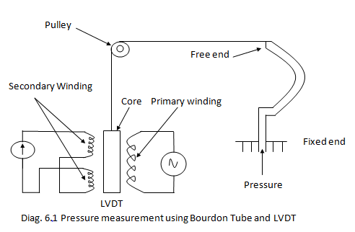
Transducer

Slide 70
Transducer
Active and passive Transducer
Active transducer
It is a self generating type, do not require external power.
Draw energy from the system under measurement.
eg. Thermocouple, photo voltaic cell etc.
Passive Transducer
It requires external power source for energy conversion.
eg. LVDT, Hall effect pickup etc.
Transducer and Inverse Transducer
Transducer
Converts physical quantities into electrical quantity.
eg. Thermocouple, Photovoltaic cell, LVDT etc.
Inverse Transducer
Converts electrical quantity into non-electrical quantity.
eg. Piezo-electric crystal, Angular moving coil elements etc.
Based on principle of Transduction
Transducer classified on the basis of principle of transduction as resistive, inductive, capacitive etc. depending upon how they convert the input quantity into resistance, inductance or capacitance respectively.

Slide 71
Transducer
Selection of Transducers
Selections of transducer includes
1.) Range
It should be large enough to encompass all expected magnitude of the measurand.
2.) Sensitivity
Transducer must provide a sufficient output per unit of input to provide meaning full data.
3.) Physical Environment
Transducer must compatible to withstand environmental conditions in which measurement
performed.
4.) Electrical output characteristics
The electrical characteristics such as output impedance, frequency response, response time required
to be compatible with recording device and rest of the measuring system equipments.
5.) Error
The Errors (Due to transducer operation itself or due to environmental conditions) must require to
controllable enough to take meaningful data under measurements.

Slide 72
Transducer
Technique adopted to reduce error within required accuracy range includes.
Transducer output calibrate against known standard and regular calibration necessarily
performed as measurement proceeded.
Monitor environmental conditions continuously and correct data according to variations.
By artificially controlling the measurement environments etc.

Slide 73
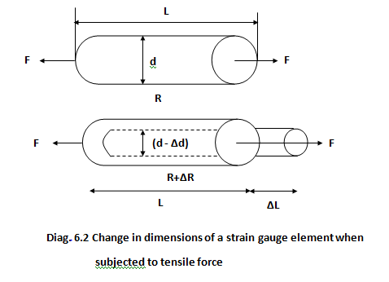
Transducer
Strain gages
A thin wafer like device that can be attached to variety of materials to measure applied strain.
A passive transducer that converts a mechanical displacement into a change of resistance.

Slide 74
Transducer(Strain gages)
Sensitivity described in terms of gauge factor K, defined as unit change in resistance per unit change in length.
Gauge factor K = [ {(∆R)/(R)} / {(∆L)/(L)}] ----- (6.1)
Where K = Gauge factor.
R = Nominal gauge resistance.
∆R = Change in gauge resistance.
L = Nominal specimen length.
∆L = Change in specimen length.
We know, R = [ρ{(L)/A}]= ρ[{L}/{Π/4}(d²)] ----- (6.2)
Specimen after subjected to tensile force, the dimensions becomes
R = R + ∆R
L = L + ∆L
d = d - ∆d
Thus, eq.n (6.2) becomes
R+∆R = ρ [{L+∆L} / {(Π/4)(d - ∆d)²}]
R+∆R = ρ [ L{1+(∆L/L)}/{(Π/4)d²{1 – (∆d/d)}²]
R+∆R = ρ{L/(Π/4)d²} [ {1+(∆L/L)}/{1 – (∆d/d)²}]

Slide 75
Transducer(Strain gages)
Substituting this value in eq.n (6.3)
[(R+∆R)/R] = [ {1+(∆L/L)} / {1 – 2µ(∆L/L)}]
[1+(∆R/R)] = [ {1+(∆L/L)}/{1 – 2µ(∆L/L)}] * [{1 + 2µ(∆L/L)}/{1+ 2µ(∆L/L)}]
[1+(∆R/R)] = [{1+2µ(∆L/L)+(∆L/L)+2µ(∆L/L)²}/{1 - 4µ²(∆L/L)²}]
Neglecting higher power terms i.e.(∆L/L)² becomes zero.
[1+(∆R/R)] = [{1+(∆L/L)(1+2µ)+0}/{1 – 0}]
[1+(∆R/R)] = [1+(∆L/L){1+2µ}]
[{∆R/R}/{∆L/L}] = [1+2µ]
----- (6.4)
R+∆R = ρ{L/(Π/4)d²}[ {1+(∆L/L)}/{1 –2 (∆d/d)+(∆d/d)²}]
Since, ∆L itself is small, thus (∆L/L)² becomes almost negligible.
R+∆R = R [ {1+(∆L/L)}/{1 – 2(∆d/d)}] ----- (6.3)
Now, Poisson’s ratio µ is defined as
µ = [(∆d/d)/(∆L/L)]
(∆d/d) = µ(∆L/L)
K = [1+2µ]

Slide 76
Transducer
A resistance strain gauge with factor of 5 is fastened to a steel member subjected to a stress of 1550 Kg/cm² . The modulus of elasticity of steel is approximately 2.1 * 10⁶ Kg/cm^{2.} . Calculate the change in resistance of strain gauge element due to applied stress and also compute Poisson’s ratio.
Metallic sensing Elements
Various materials have been developed for use in wire and foil gages.
1. Constantan
It’s a alloy of copper and nickel with low temperature coefficient.
Used in dynamic strain measurements.
Temperature limit from 10 ͘c to 200 ͘c.
2. Nichrome V
It’s a alloy of nickel and chromel used for static and dynamic measurements.
For static, temp. ranges 375 ͘c to 650 ͘c.
For dynamic, temp. ranges upto 1000 ͘c.
3. Dynaloy
It’s a alloy of nickel and iron with high gauge factor and a high resistance to fatigue.
Used in dynamic strain measurement.

Slide 77
Transducer
4. Stabiloy
It’s a modified alloy of nickel and chromel with wide temperature compensation range.
It posses excellent stability and good fatigue life.
Temp. range is up to 350 ͘c.
5. Platinum Tungsten alloys
It posses excellent stability and high resistance to fatigue.
Used for both static test and dynamic measurement.
For static, temp. range up to 700 ͘c.
For dynamic, temp. range up to 850 ͘c.
6. Semiconductor strain gauge
It is often used in high output transducers such as load cells.
It is very sensitive.
Gauge factor lies in the range 50 to 200.

Slide 78
Displacement Transducer
Force summing device
Mechanical elements used to convert the applied force into a displacement are called force summing device.
Most often used force summing devices are:
Diaphragm
Bellows
Bourdon tube
Straight tube
Mass cantilever
Pivot torque etc.
Diaphragm, Bellows, Bourdon tube & Straight tube etc. used for pressure measurement.
Mass cantilever, Pivot torque used in accelerometer and vibration pickup.
Displacement formed by action of force summing device is converted into a change of some electrical parameter by using suitable transducer.

Slide 79
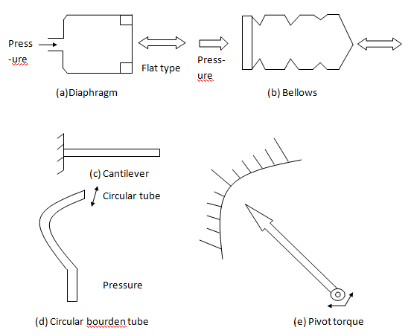
Force summing device

Slide 80
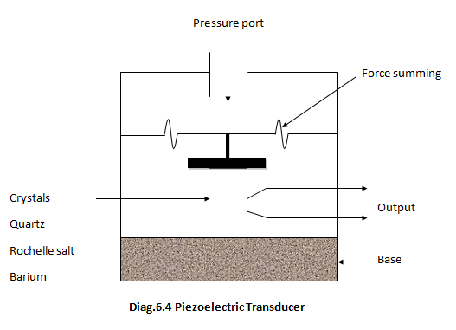
Piezoelectric pickup Transducer
titanate

Slide 81
Piezoelectric pickup
When asymmetrical crystalline materials (Quartz, Rochelle salt, Barium titanate etc.) subjected under stress , an emf produced.
An emf produced depends upon three parameters
Magnitude of pressure applied.
Voltage Sensitivity.
Thickness of crystal.
Vout = gtp
where g = Voltage sensitivity
t = Thickness of crystal
p = Pressure applied.
Force
O2(-4)
Si(+4)
Si(+4)
+
-
O2(-4)
O2(-4)
Force
Si(+4)

Slide 82
Piezoelectric pickup
The opposite side of crystal get charged on application of force.
The charge generated is defined as
Q = d.F. ----- (7.1)
Where F = Force applied
d = Charge sensitivity
d = Ɛo Ɛr g ----- (7.2)
The charge at electrodes give rise to an output voltage Vout as
Vout = [(Q)/(Cc)] ----- (7.3)
Where Cc is capacitance pickup.
Since Cc = [{ƐoƐrA}/(t)} ----- (7.4)
where A = Area of crystal in m²
t = Thickness of crystal in m.
Ɛr = Relative permittivity.
Vout = [{Q}/{Cc}] = [{d.F.} / {ƐoƐrA}/(t)}] = {(d)/(ƐoƐr)} * {(F.t)/A}
= gtp. ------ (7.5)
High frequency response thus use in high frequency accelerometers.
Self generating type.
Can’t measure static conditions.

Slide 83
Transducer
A Quartz piezoelectric pickup has dimension of 10mm*10mm*2.5mm and a voltage sensitivity of 0.012Vm/N. The relative permittivity of the quartz is 1600 and modulus of elasticity of the quartz is 12*10¹⁰N/m². The force applied to the pickup is 20N.
Analytically compute
a) The output voltage.
b) Charge sensitivity.
c) Strain.
d) Charge generated.
e) The capacitance pickup.

Slide 84
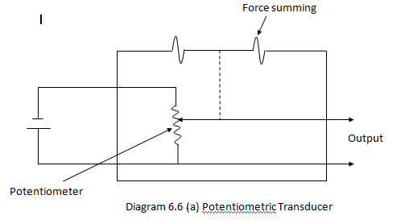
Potentiometric Transducer
Electromechanical device containing resistance element contacted by movable slider.
Slider motion result in resistance change that may be linear, logarithmic, exponential and so on depending on the manner in which the resistance wire is wounded.
Displacement provided to slider of rheostat by force summing device or micrometer screw gauge.
Output voltage directly depends upon the slider position.
Slider movement results in resistance change which further results in corresponding change in output voltage.
E

Slide 85
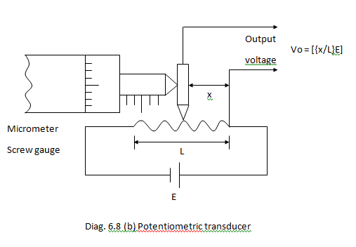
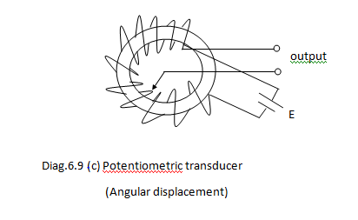
Potentiometric Transducer
Vo = [{x/L} E] ----- (6.7)
where x = Slider displacement.
L = Length of rheostat.
E = External power source.
The output voltage Vo can be written as
Vo ∞ x ----- (6.8)
Thus, output voltage depends on displacement covered by slider.

Slide 86
Linear Variable Differential Transformer (LVDT)
Transformer consists one primary winding and two secondary windings.
There is provision to displace core.
Both secondary coils are identical, i.e. same number of turns, same cross section, made of from same material etc.
Two secondary coils connected in series opposition so that emf induced in coil opposes each other.
As core is displaced, the magnetic flux linkage between primary and secondary changes.
For a transformer, [E1/E2] = [N1/N2] = [I2/I1].
Case I when core is at center.
The induced emf in the secondary becomes equal and since they opposes each other, the differential output voltage becomes zero.
Differential output voltage (E1 – E2) = 0.
Case ii when core is towards Left .
The induced emf at left becomes larger in magnitude than emf at right.
Differential output voltage (E1 – E2) = + Ve.
Case iii when core is towards Right .
The induced emf at left becomes smaller in magnitude than emf at right.
Differential output voltage (E1 – E2) = - Ve.

Slide 87
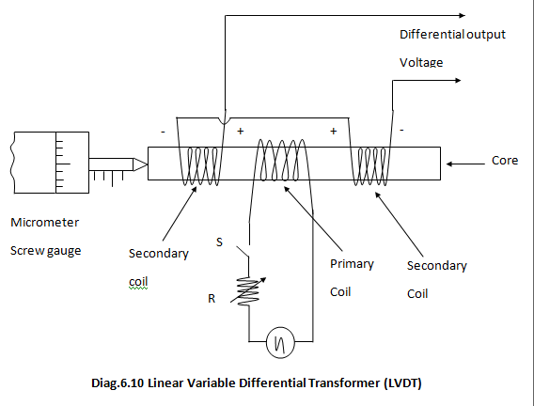
Linear Variable Differential Transformer (LVDT)

Slide 88
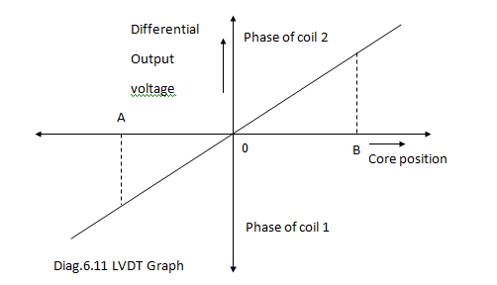
Linear Variable Differential Transformer (LVDT)

Slide 89
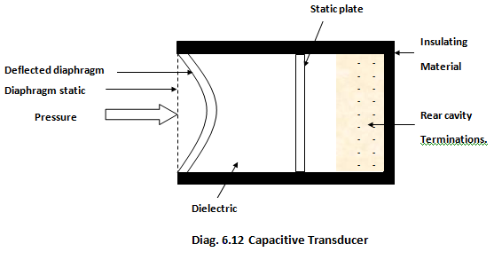
Capacitive Transducer
The capacitance value for parallel plate capacitor is given by
C = [{ƐA}/d]
Where Ɛ = ƐoƐr
Ɛr = Relative permittivity of dielectric.
A = Area of each plate in m².
d = Distance between two plate in m.

Slide 90
Capacitive Transducer
Ɛo = 8.85*10⁻¹²F/m.
Capacitance is inversely proportional to d, As d changes, the value of capacitance will change.
Capacitor transducer is a part of oscillator circuit.
Frequency of oscillation changes as d changes.
The change in frequency measure the magnitude of non-electrical quantity (force, displacement etc.) under measurement.
It is passive transducer in which capacitance get varied by following three methods.
By varying distance between plates.
By varying overlapping area of plates.
By varying relative permittivity of dielectric material between two plates.

Slide 91
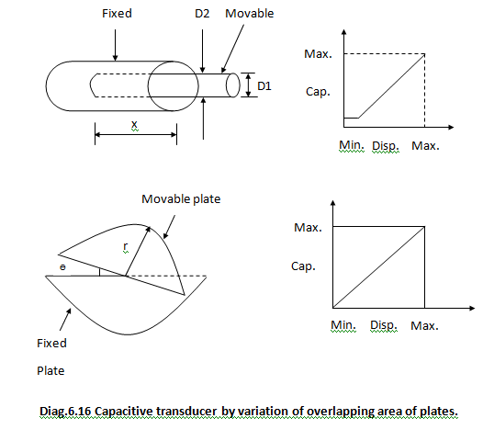
Capacitive Transducer
The capacitance value for cylindrical capacitor is
C = [{2ΠƐx}/{log(D2/D1)}]
Where
D2 = Inner diameter of outer cylinder.
D1 = Outer diameter of inner cylinder.
X = Length of overlapping part of cylinder.
The sensitivity is defined as
S = [∂C/∂X] = [(2ΠƐ)/log{D2/D1}]
The relationship between capacitance and displacement is shown in diagram.
The value of capacitance for circular plate with angular displacement is
C = [{ƐӨr²}/(2d)]

Slide 92
Capacitive Transducer
where r = Radius of movable plate.
d = Distance between two circular plates in m.
The sensitivity is expressed as
S = [∂C/∂Ө] = [Ɛr²/2d]
The relationship between capacitance and displacement is shown in diagram.
The value of capacitance for parallel plate capacitor is
C = [{ƐWx}/d]
where W = width of fixed plate in m.
x = Length of over lapping portion of plate in m.
The sensitivity is expressed as
S = [∂C/∂x] = [{ƐW}/d]
Capacitive transducer by varying distance between plates
As distance between plate varies, the capacitance changes.
The change in capacitance measured by an A.C. bridge or an oscillator circuit.
The sensitivity is expressed as
s = [∂C/∂d] = -[{ƐoƐr A}/d²] = - [{ƐA}/d²]

Slide 93
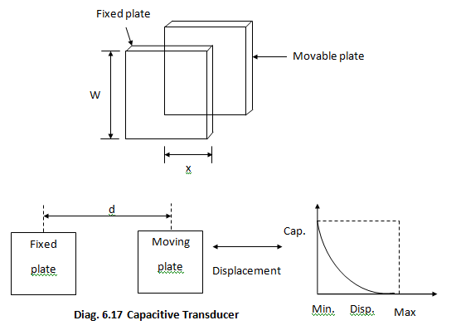
Capacitive Transducer

Slide 94
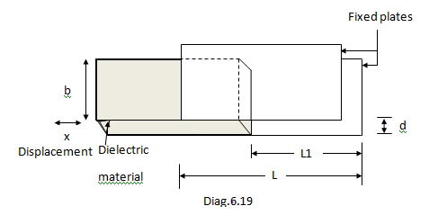
Capacitive Transducer
By variation of permittivity of Dielectric material between plates
The transducer capacitance varied by varying the permittivity of dielectric material between plates.
Ɛr moves between two fixed parallel plates according to displacement under measurement.

Slide 95
Capacitive Transducer
The value of capacitance expressed as
C = Ɛo {(bL1)/d} + ƐoƐrb {(L-L1)/d} ----- (7.22)
= Ɛo {b/d} [L1 + Ɛr (L-L1)] ----- (7.23)
Now, Let dielectric material moves out a distance x, then capacitance changes from C to C - ∆C.
C - ∆C = Ɛo{b/d} (L1+x) + ƐoƐr {b/d} [L-(L1+x)] ----- (7.24)
= Ɛo{b/d} [ (L1+X)+ ƐrL – Ɛr (L1+x)]
= Ɛo {b/d} [{L1+x} + Ɛr (L – L1) – Ɛr x]
= Ɛo{b/d} [ L1 + Ɛr ( L - L1 )] – Ɛo {b/d}x (Ɛr – 1)
= C – [ {(Ɛobx)/d} (Ɛr – 1) ----- (7.25)
= C - ∆C
∆C = [{(Ɛobx)/d} (Ɛr – 1) ----- (7.26)
The change in capacitance becomes proportional to displacement.
Displacement from 1µm to 10mm could be measured via this method.

Slide 96
Capacitive / Inductive Transducer
A capacitive transducer uses two quartz diaphragms of area 500mm² separated by a distance of 2.25mm. A pressure of 5x10⁵N/m², when applied to the top of diaphragm causes a deflection of 0.25mm. The Capacitance is 500x10⁻¹²F, when no pressure is applied to the diaphragms. Determine the value of capacitance after application of a pressure of a 10x10⁵N/m².
Inductive Transducer
It is a passive transducer which operates on following three principles
Variation of self inductance of coil
Variation of mutual inductance of coil.
Production of eddy current.
Variation of self inductance of coil
The value of self inductance of a coil is given as
L = [(N²)/{l/µA}] = [{(N²)µA}/l] = N²µG ----- (7.27)
where, N = Number of turns of coil.
l = Mean length of magnetic path.
A = Area of x-section of magnetic path.
µ = Permeability of magnetic material.
G = Geometric configuration of magnetic circuit.

Slide 97
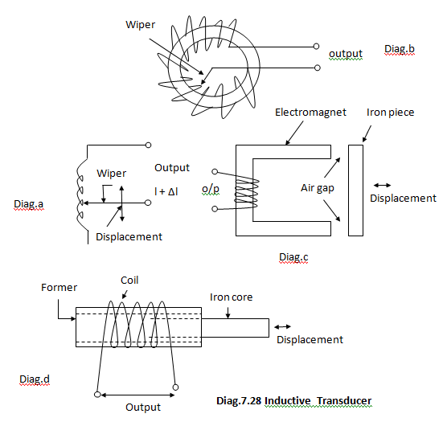
Inductive Transducer
By variation in number of turns:
Transducer used for linear and angular displacement is shown in diag.7.28 a & b respectively.
The self inductance varies as the square of displacement. i.e.
L = N² ∞ (displacement)²
By variation of permeability of magnetic circuit:
Illustrated in diagram 7.28 d.
When iron core completely inside coil, self inductance becomes maximum due to increased flux value.
As iron core moves out the reluctance increases causing decrease in flux which result in decrease in self inductance L of the coil.

Slide 98
Inductive Transducer
By variation of reluctance of magnetic circuit:
Illustrated in diagram 7.28 c.
Reluctance of magnetic circuit
S = Si + Sg
where S = Sum of reluctance of iron path.
Si = Reluctance of iron.
Sg = Reluctance of air gap.
Si value becomes negligible as compare to Sg. Thus,
S = Sg
The self inductance value of coil
L = [N²/S_{g}]
L ∞[1/S_{g}] = [1/L_{g}]
Where L_{g} is the length of air gap.

Slide 99
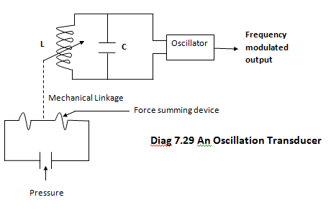
Oscillation Transducer
Force summing device use to change capacitance or inductance in an LC oscillator circuit.
Oscillator must have excellent stability to detect change in oscillator frequency.

Slide 100
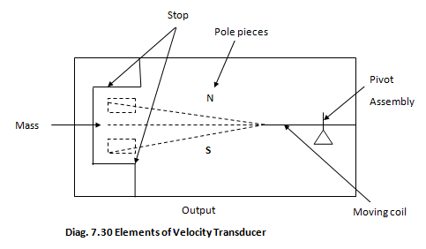
Velocity Transducer
Moving coil suspended in permanent magnetic field.
Motion of coil in the field generate voltage.
Output becomes proportional to velocity of coil and type of pickup.
Generally, used for measurement of velocities developed in a linear, sinusoidal or random manner.

Slide 101
Temperature Measurements
Resistance Temperature Detector (RTD)
All most all pure metals have property of varying resistances with temperature.
The change in resistance becomes almost directly proportional to the change in temperature.
The relationship between resistance and temperature.
R_{T} = R_{O}[1+α₁T¹+α₂T²+α₃T³ + ------------ +α_{n}T^{n}] ----- (7.31)
Where
RT = Resistance of metal at temperature T ͘C.
RO = Resistance of metal at temperature O ͘C.
α₁, α₂, α₃, ----- α_{n} = Temp. coefficient determined on the basis of two or more known resistance temp. points.
The number of term depends upon desired accuracy and range of operation.
For normal range device operates linearly.
R_{T} = R_{O} [1+α₁∆T]
∆T = T – T_{O}.
R_{T} = R_{O} [1+α₁ (T – T_{O}) ]
The value of α can be obtained from graph. In general,
α₁ = [1/R_{O}] slope at T_{O}
α₁ = [1/Ro] x [{R₂ –R₁}/{T₂ –T₁}]
The unit of α is 1/ ͘c or 1/ ͘F.

Slide 102
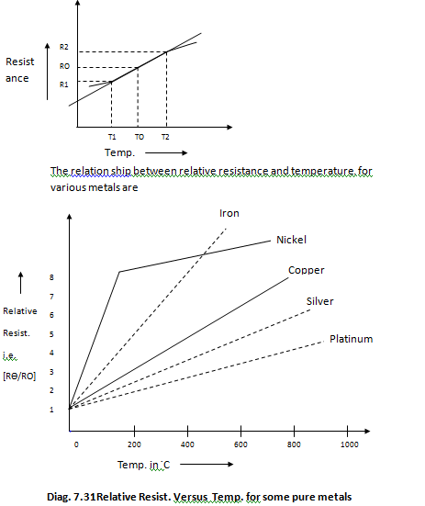
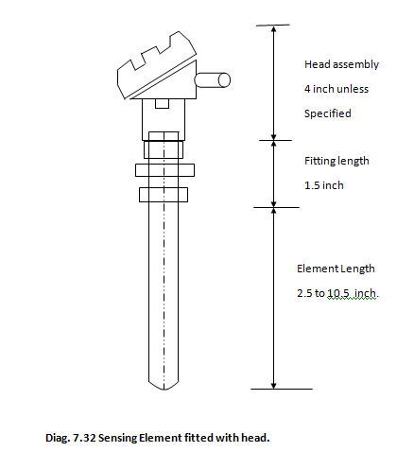
RTD
Construction

Slide 103
RTD
Probe type for immersion purpose.
Immersed into medium whose temp. is to be measured or controlled.
Sensing element constructed by coating a small platinum or silver tube with ceramic material.
Resistance wire winded over coated tube.
Winding again coated by ceramic and heated to a very high temperature.
Provide mechanical strength to winding & sensing element.
Finally, kept at tip to probe.

Slide 104
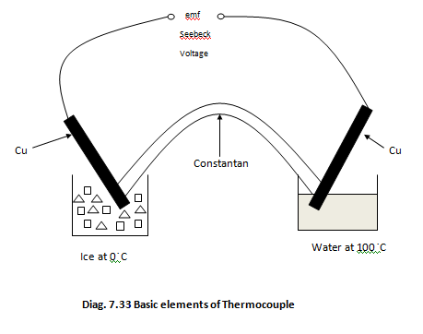
Thermocouple
Thomas seebeck discovered that when two dissimilar metals becomes in contact, an emf produced that becomes the function of temperature.
Device consisting two dissimilar metals joined together is called thermocouple and voltage is seebeck voltage.
When two junction formed by two dissimilar metals kept at different temperature, an emf produced that becomes directly proportional to temperature difference.

Slide 105
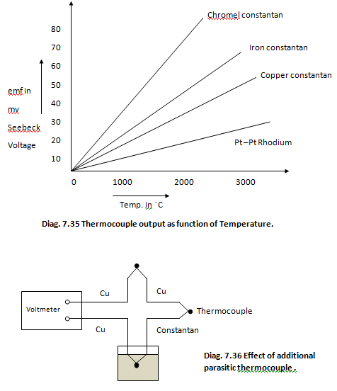
Thermocouple
The relation between the thermo emf set up and temperature difference of hot and cold (reference junction) junction is
E = α(T – To) + β(T² – T_{O}²)
Two metals A & B joined together to form two junctions J1 & J2 maintained at temp. T1 & T2 respectively, then an infinite resistance voltmeter detects electromotive force and low resistance ammeter detects current I flow & measured via it.
͘F
Zero

Slide 106
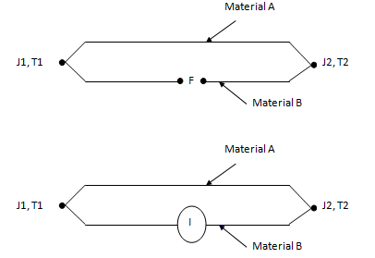
Thermocouple
Laws governing Thermocouples
Law of Intermediate temperature.
Law of Intermediate Metals.
Law of Intermediate temperature
emf generated in a thermocouple with junction at temperature T1 and T3 becomes equal to sum of the emf generated by similar thermocouple, one acting between temperature T1 and T2 and other between T2 and T3 where T2 lies between T1 and T3.

Slide 107
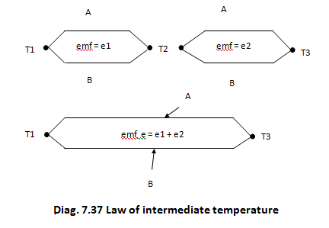
Thermocouple
Law of intermediate Metals
Basic thermocouple loop consists of two dissimilar metals A & B. If a third wire require to introduced then three junctions are formed. The emf generated remains unaltered if two new junction B-C and C-A are at the same temperature.

Slide 108
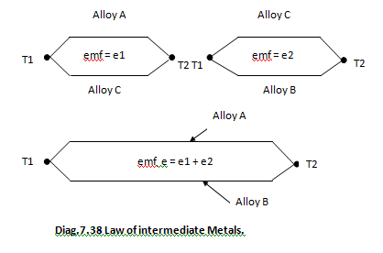
Thermocouple
Sources of Errors in Thermocouple
1. Open junction
Large magnitude errors get occurred due to open junction.
Which easily detected by measuring resistance of thermocouple.
2. Decalibration
It occur due to change in change in characteristics of thermocouple wire.
At excessive high temp. particals or liquid from atmosphere diffused into wire.
Properties of wire changed which causes error in Seebeck voltage.

Slide 109
Thermocouple
3. Insulation degradation
At high temperature, insulation can break down.
Causes leakage resistance which result in error in Seebeck voltage.
4. Galvanic Action
Chemicals coming in contact with thermocouple wire can cause galvanic action.
Due to this extreme error occurs.
Resultant voltage becomes as much as 100 times the Seebeck Voltage.
5. Thermal conduction
Thermocouple wire shunt heat energy away from the source to be measured.
Small diameter thermocouple wire could be used.
Thermocouple extension wire can be used.

Slide 110
Thermistor
Semiconductor device having negative temperature coefficient of resistance.
Resistance changes with temperature i.e. Resistance decreases with increase in temperature and vice-versa.
For each 1 ͘C rise in temperature, the Resistance value decrease as much as 6% and vice-versa.
Its lower temperature range is -100 ͘C to 300 ͘C.
Thermistor posses non-linear characteristics.
Resistance value ranges from 0.5 Ω to 75 MΩ.
The resistance R of a thermistor at temperature T expressed as
R_{T} = R_{O} e^{β} (1/T – 1/T_{O})
Where RT = Resistance at temperature T.
RO = Resistance at temperature TO.
β = Experimentally determined constant or curve fitting
Constant for given thermistor material.
β usually lie between 2000 to 4000.
Thermitor composed of sintered mixture of metallic oxides.
NICCUM
Nickel
Iron
Copper
Cobalt
Uranium
Manganese

Slide 111
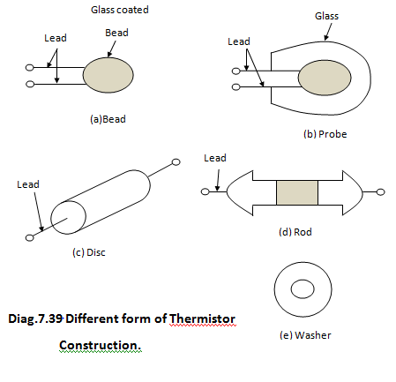
Thermistor
Available in variety of shapes and sizes.

Slide 112
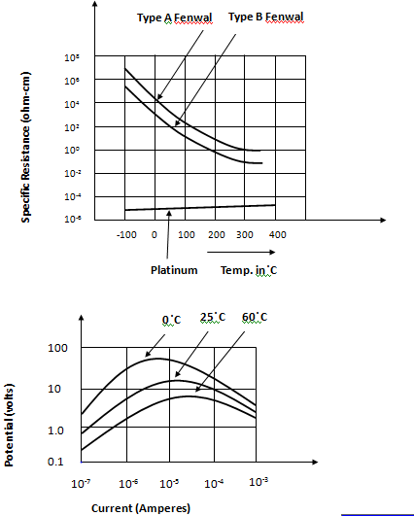
Thermistor characteristics

Slide 113
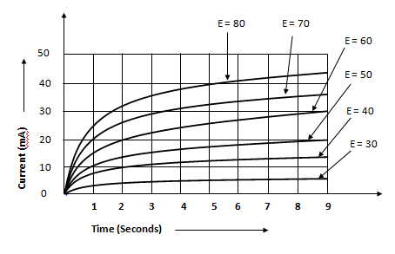
Thermistor characteristics

Slide 114
Hall Effect Transducer
When a conductor kept perpendicular to the magnetic field and a direct current is passed via it, then it results in an electric field perpendicular to the direction of both the magnetic field and current with a magnitude proportional to the product of the magnetic field strength and current.
The voltage so developed is very small and it becomes difficult to detect it.
But in germanium, voltage becomes sufficient enough for measurement with a sensitive moving coil instrument.
This phenomenon is termed as Hall-effect.
The magnitude of voltage expressed as
V_{H} = [{K_{H}IB} / t] ----- (7.40)
where,
I = Current flow via slab in Ampere.
B = Flux density of magnetic field in Tesla or Wb/m²
t = Thickness of slab in meter.
K_{H} = Hall effect coefficient.

Slide 115
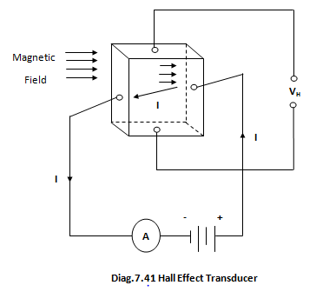
Hall Effect Transducer
An Hall-effect transducer used for measuring a magnetic field strength provides an output voltage of 15.5 mV. The element is made of silicon and is 2.5mm thick and carries a current of 10A. The hall coefficient is 4.1x10⁻⁶ Vm/A-wb/m².

Slide 116
Signal conditioning and processing
Signal conditioning and processing
The first stage “Detector transducer stage” the physical quantity detected and further transduced into an electrical form.
Modify the transduced signal into a usable format for final stage of measurement system.
It requires linear processes like amplification, integration, differentiation, addition & subtraction etc.
It also require non-linear function like modulation, demodulation, sampling, filtering, clipping & clamping etc.
It requires ingenuity in proper selection of components and faithful methods of reproduction of output for final stage.
Both active and passive transducers are used.
Both A.C. & D.C. excitation voltage source are used.
D.C. system consists transducer, bridge, calibration & zeroing network, D.C. amplifier, low pass filter and D.C. output etc.
D.C. amplifier characteristics are
Require balance differential input yielding high CMRR.
Have extremely good thermal and long term stability.
D.C. Amplifier advantages
Easy to calibrate at low frequency.
Able to recover from an overload condition.

Slide 117
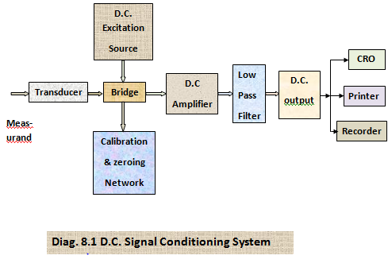
D.C. Signal conditioning system

Slide 118
Signal conditioning and processing
D.C. System suffer from problem of drift.
Low pass filter used to eliminate high frequency components or noise from data signal.
A.C. Signal conditioning System
A.C. Signal conditioning System used to overcome the difficulties encountered in D.C. system.
A.C. system does not suffer the problem of drift.
The modulated signal get amplified by A.C. amplifier and demodulated by phase sensitive demodulator.
The phase sensitive demodulator filters out the carrier frequency from the data signal.
Differences between D.C. and A.C. System
D.C. system suffer from problem of drift while A.C. system does not suffer from problem of drift.
D.C. system is simpler while A.C. system is comparatively complex.
Normally, A.C system used for long distance communication via cable i.e. when transmitter and receiver are very apart from each other.

Slide 119
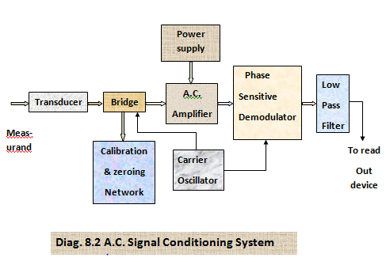
A.C. Signal conditioning system
Reference

Slide 120
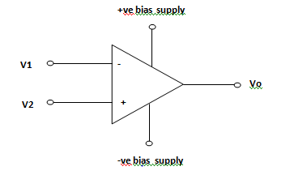
OPAMP
Opamp
Deffined as high gain, high input impedance directly coupled negative feedback amplifier to amplifier signal in frequency range from 0Hz to beyond 1MHz.
Opamp configuration
Opamp characteristics
An ideal opamp characteristics are:
Open loop gain i.e Av = -∞
Input impedance i.e. Zin = ∞
Output impedance i.e. Zo = o.
Band-width i.e. B.W. = ∞
At perfect balance V1 = V2.
Common Mode Rejection Ratio i.e. CMRR = ∞.
Drift characteristics with temperature is nill.
Slew rate is infinite.
7
2
6
3
4

Slide 121
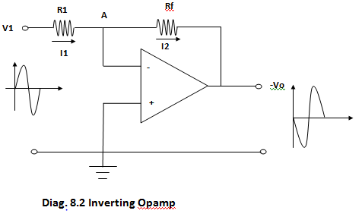
OPAMP
Inverting opamp
From diag.
i1 = [V1/R1] & i2 = - [Vo/Rf]
Applying KCL at A,
i1 + (-i2) = 0 ----- (8.1)
[{V1/R1} + [-{-Vo/Rf}] = 0
{V1/R1} + {Vo/Rf} = 0
{V1/R1} = - {Vo/Rf}
{Vo/V1} = -{Rf/R1}
Av = - {Rf/R1} ----- (8.2}
Vo = - {Rf/R1} V1 ----- (8.3)

Slide 122
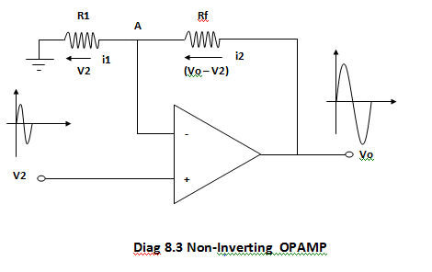
Inverting opamp
Due to virtual short between two opamp terminals, voltage across R1 becomes V2 and across Rf becomes (Vo – V2).
From diagram,
i1 = [V2/R1] ----- (8.4)
i2 = [(Vo-V2)/Rf] ----- (8.5)
Applying KCL at node A.
- (i1) + (i2) = 0 ----- (8.6)
-(V2/R1) + {(Vo – V2)/Rf} = 0
{Vo/Rf} = [(V2/R1)+V2/Rf)]
(Vo/Rf) = V2[(R1+Rf)/(R1Rf)]
(Vo/V2) = Rf [(R1+Rf)/(R1Rf)]
(Vo/V2) = [(R1+Rf)/R1]
(Vo/V2) = [1+(Rf/R1)]
Av = [1+(Rf/R1)] ----- (8.7)
Vo = [1+(Rf/R1)] v2 ----- (8.8)

Slide 123
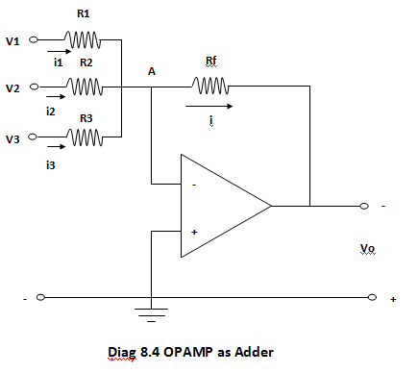
OPAMP as Adder
Opamp as Adder
Provides an output voltage proportional to algebraic sum of two or more input voltages each multiplied by a constant gain factor.

Slide 124
OPAMP as Adder
From diagram,
i1 = (V1/R1), i2 = (V1/R2), i3 = (V3/R3)
and I = - (Vo/Rf).
Applying KCL at node A.
i1 +i2 + i3 + (-i) = 0. ----- (8.9)
[(V1/R1)+(V2/R2)+(V3/R3)+{-(-Vo/Rf)}] = o.
[(V1/R1)+(V2/R2)+(V3/R3)+(Vo/Rf)] = 0.
(Vo/Rf) = - [(V1/R1)+(V2/R2)+(V3/R3)]
Vo = - [(Rf/R1)V1+(Rf/R2)V2+(Rf/R3)V3]
Vo = - [K1V1+K2V2+K3V3] ----- (8.9)
If R1= R2 =R3 = R, then
V0 = - (Rf/R) [V1+V2+V3]
Vo = -K [V1+V2+V3] ----- (8.10)
Thus, Output becomes proportional to algebraic sum of three input voltages.

Slide 125
Opamp as Subtractor
Provides an output proportional to the difference of two input signals.
According to superposition theorem,
Vo = Vo’ + Vo’’ ----- (8.11)
Where Vo’ = Output produce by V1.
Vo’’ = Output produce by V2.
Vo’ = - {Rf/R1} V1 from eq. (8.3)
Vo’’ = [1+{Rf/R1}]V2 from eq. (8.8)
From eq. (8.11)
Vo = - (Rf/R1)V1 + {1+(Rf/R1)}V2
Vo = - {Rf/R1}V2 + {Rf/R1} V1 [Rf >>R1, Rf/R1>>R1]
Vo = {Rf/R1} (V2 – V1)
Vo = K (V2 – V1)
If Rf = R1, Then Vo = (V2 – V1) ----- (8.12)
Thus, Output becomes equal to the difference of two inputs.

Slide 126
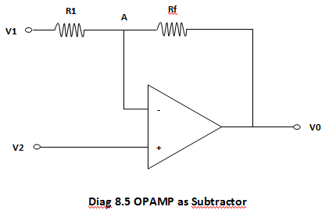
Opamp as Subtractor
Design an Adder circuit using an OPAMP to get an expression for output as
Vo = - V1 + 8V2 – 12V3 + 16V4 .

Slide 127
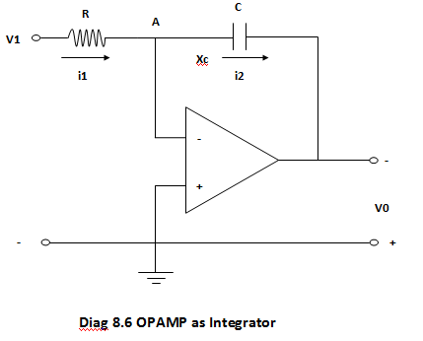
OPAMP as Integrator
Provides an output voltage becomes proportional to integral of input voltage.
From diagram,
i1 = V1/R
i2 = - (Vo/Xc) = - [ Vo/{1/(jwC)}]
i2 = - [ Vo/{1/(SC)}] = - SCVo

Slide 128
OPAMP as Integrator
Where, S = jw in Laplace notation.
Now, applying KCL at point A.
i1 + (- i2) = 0. ----- (8.13)
i1 = i2
{V1/R} = -SCVo
{Vo/V1} = - {1/(SCR)]
{Vo/Vin} = {Vo/V1} = - {1/(SCR)}
Av = - {1/(SCR)} ----- (8.14)
Writing in terms of time domain
Vo(t) = - {1/(CR)} ʃ V1(t) dt ----- (8.15)
Thus, Output expression becomes proportional to the integral of input with scale factor as –[1/CR].

Slide 129

OPAMP as Differentiator
Provides an output proportional to the rate of change of input voltage.
We know very well,
i= Rate of change of Charge.
i = {(dQ)/(dt)} ----- (8.16)
But Q = CVc ----- (8.17)

Slide 130
OPAMP as Differentiator
From eq. (8.16)
i = {d/dt} [CVc]
= C [ d(Vc)/dt]
The output Vo can be written as Vo = - (iR)
Vo = - C [ d(Vc)/dt] R
Vo = - CR [(dVc)/dt] ----- (8.18)
Thus, Output voltage becomes proportional to the derivatives of the input voltage with scale factor
as ( - CR ).

Slide 131
Instrumentation Amplifier
The important characteristics of an Instrumentation Amplifier that set it apart from OPAMP are
The instrumentation amplifier have finite gain selectable within precise value of range with high gain accuracy and high gain linearity.
The instrumentation amplifier has a high impedance differential input.
The instrumentation amplifier has high common mode rejection ratio (CMRR) and a high common mode voltage range.
The instrumentation amplifier has high stability of gain with low temperature coefficient.
Listed out characteristics make instrumentation amplifier superior over Opamp.

Slide 132

Instrumentation Amplifier

Slide 133
Instrumentation Amplifier
From diagram, we can write
(V01 – V1)/R2 = (V1 –V2)/R1 ----- (8.19)
{Vo1/R2} = {V1/R1} + {V1/R2} – {V2/R1}
Vo1 = [{R2/R1} V1 + V1 – {R2/R1} V2]
Vo1 = [V1 + {R2/R1} (V1 – V2)] ----- (8.20)
Similarly, we can also write
(V2 – Vo2)/R2 = (V1 –V2)/R1
- {Vo2/R2} = {V1/R1} - {V2/R2} – {V2/R1}
{Vo2/R2} = {V2/R2} + {V2/R1} – {V1/R1}
Vo2 = [V2 + {R2/R1} V2 – {R2/R1} V1]
Vo2 = [V2 + {R2/R1} (V2 – V1)] ----- (8.21)
From eq. (8.20) & eq.(8.21)
(Vo1 – Vo2) = [V1 + {R2/R1} (V1 – V2)] - [V2 + {R2/R1} (V2 – V1)]
= (V1 – V2) + {R2/R1}V1 – {R2/R1}V2 – {R2/R1}V2 + {R2/R1}V1 ----- (8.22)
= (V1 - V2) + 2{R2/R1}V1 – 2{R2/R1}V2
= [(V1 – V2) + 2{R2/R1} (V1 – V2)]
(Vo1 – Vo2) = (V1 – V2) [ 1+ 2{R2/R1}] ----- (8.23)

Slide 134
Instrumentation Amplifier
Applying KCL at node Va,
[ {(Va – Vo1)/R3} + {(Va – Vo)/R4}] = 0.
[{Va/R3} + {Va/R4} – {Vo1/R3} – {Vo/R4}] = 0.
{Vo/R4} = [{Va/R3} + {Va/R4} – {Vo1/R3}]
{Va/R3} + {Va/R4} = [{Vo/R4} + {Vo1/R3}]
Va [{(R3+R4)/(R3R4)}] = [{Vo/R4} + {Vo1/R3}]
Va = [{R3/(R3+R4)}Vo + {R4/(R3+R4)}Vo1] ----- (8.24)
Similarly, Applying KCL at Vb.
[{(Vb – Vo2)/R3} + {Vb/R4}] = 0.
[{Vb/R3} + {Vb/R4} – {Vo2/R3}] = 0.
Vb [{(R3+R4)/(R3R4)}] = [{Vo2/R3}]
Vb = [{R4/(R3+R4)}Vo2] ----- (8.25)
At perfect balance, Va must be equal to Vb.
Va = Vb

Slide 135
Instrumentation Amplifier
[{R3/(R3+R4)}Vo + {R4/(R3+R4)}Vo1] = [{R4/(R3+R4)}Vo2]
{R3/(R3+R4)}Vo = [{R4/(R3+R4)}Vo2] – [{R4/(R3+R4)}Vo1]
{R3/(R3+R4)}Vo = {R4/(R3+R4)} (Vo2 – Vo1)
Vo = {R4/R3} (Vo2 – Vo1)
Vo = - {R4/R3} (Vo1 – Vo2) ----- (8.26)
From eq. (8.23) & eq. (8.26), we can write
Vo = - {R4/R3} (V1 – V2) [ 1+ 2{R2/R1}]
Vo = {R4/R3} (V2 – V1) [ 1+ 2{R2/R1}] ----- (8.27)
The gain can be expressed as
Av = [Vo/(V2 – V1)]
Av = {R4/R3} [1+ 2(R2/R1)] ----- (8.28)

Slide 136

Isolation Amplifier
A special sub-class of Instrumentation amplifier used for many applications.
Isolation achieved via several means such as by use of Transformers, Photo resistors, Hall-effect devices, and Thermal couplers etc.

Slide 137

Isolation Amplifier

Slide 138
Isolation Amplifier
The ordinary instrumentation amplifier require a return path for bias current.
On absence of return path , the output get drift excessively.
Isolation Amplifier does not require such a ground connection.
Signal input circuit isolated from signal output & power circuit.
Due to matched characteristics of two LED photo transistor pairs, the non linear characteristics and temperature dependence get compensated.

Slide 139
Output Devices
The data presentation devices are termed as output devices.
Strip Chart Recorder
Records both electrical and non-electrical quantities as a function of time.
Long roll of graph moves vertically.
Paper driven by drive system D & speed get controlled by chart speed selector S.
Normally, chart speed of 1-100mm/s is used.
Stylus moves horizontally in proportion to the quantity being recorded.
Range selector R keeps input within acceptable level.
Pointer moves over calibrated scale thus showing instantaneous value of quantity being recorded.

Slide 140

Output Devices

Slide 141
Output Devices
X-Y Recorder
Provides a graphic record of relationship between two variables.
An emf plotted as a function of another emf.
One self balancing potentiometer control the position of paper rolls while another self balancing potentiometer controls the position of the recording pen (stylus).
Attenuator keeps input signal within acceptable level.
Balance circuit compare two signal and difference between input signal & reference signal is fed to a chopper circuit “C”.
Chopper circuit converts D.C. signal to an A.C. signal.
Amplifier then amplify signal in order to actuate servomotors MP and MA.
The action mentioned above takes place in both axes simultaneously and thus one can get a record of one quantity with respect to another.
An X-Y Recorder have
Sensitivity about 10µv/mm.
Slewing speed about 15m/s.
Frequency response about 6Hz.
Chart size about (250x180)mm.
Accuracy about ±0.3% .

Slide 142

X-Y Recorder

Slide 143
Magnetic Tape Recorder
It used to record analog data in such a way that can be retrieved in electrical form again.
Tape Transport Mechanism
Move tape along recording head or reproduce head at constant speed.
Handles tape during various modes of operation without wearing tape.
Consists supply reel, record &reproduce head, tape, tape roller, take up reel etc.
Magnetic Tape
Composed to coating of Iron Oxide (Fe₂O₃) particles on plastic ribbon.
Typical size of tape is 12.7mm wide and 25.4µm thick.
Magnetic particles conform to magnetic pattern get induced in them and retained in it.
Conditioning Device
Includes Amplifiers and Filters that needed for modify signal to a format recorded on a tape.
Recording Head
Respond to electrical signal and creates magnetic pattern on a magnetizable medium.
When recording current passed via coil, creates magnetic fluxes allow to pass via air gap(5-15µm) to come in contact with magnetic tape, thereby magnetizing Iron Oxide particles, thus actual recording takes place.
Reproduce Head
Detects magnetic patterns stored in them and convert it back to original electrical signal.

Slide 144

Magnetic Tape Recorder

Slide 145

Magnetic Tape Recorder

Slide 146
Data Acquisition System(DAS)
DAS
Relates to process of collecting input data in digital form as rapidly, accurately, completely and economically as necessary.
Generally, Analog data acquired and converted into digital form for the purpose of processing, transmission, display and storage.
Based on environment a broad classification divides DAS into two categories.
One that becomes suitable for favorable environments (minimum radio frequency interference and electromagnetic induction)
Another that intended for Hostile environments.

Slide 147

Data Acquisition System(DAS)

Slide 148
Data Acquisition System(DAS)
Analog Data Acquisition System
Transducer
emf obtained from transducer used as input to DAS.
Signal Conditioning
Include equipments that help in transforming the transducer output to desired form required by next stage of DAS.
Multiplexer
Accepts multiple inputs and sequentially connects them to one measuring instrument.
Signal converter
Translates Analog signal to suitable form that becomes acceptable by A/D converter. eg. Amplifier.
A/D Converter
Converts Analog voltage to its equivalent digital form.

Slide 149

Data Acquisition System(DAS)
Digital Recorder
Records digital information on punch cards, Perforated paper tape, Magnetic tape etc.
Auxiliary Equipments
Consists equipments for “system programming function” & “Digital Data Processing”.

Slide 150

Modern Digital Data Acquisition System

Slide 151
Signal Conversion
Signal Conversion
1.Digital to Analog Conversion.
2.Analog to Digital conversion.
Digital to Analog conversion
1.Weighted Resistor DAC
2.R-2R Ladder DAC.
Analog to Digital conversion
1.Successive Approximation Method.
2.Single and Dual slope integration.
3.Voltage to Frequency conversion.
4.Counter and Servo type.
5.Parallel types – flash converters.

Slide 152

Weighted Resistor DAC

Slide 153
Weighted Resistor DAC
The opening and closing of switches determined by value of logic inputs.
For input at logic low, switch remains open and at logic high switch becomes close.
The OPAMP acts as Summer amplifier that produce weighted sum of binary inputs.
Vout = - [VA +(1/2)VB + (1/4)VC + (1/8)VD+ - - - - - - - + {1/(2 ^{n – 1})}VH].
For example, for input 1101, the output becomes
Vout = - [8 + (1/2) 8 + (1/4) 0 + (1/8) 8]
= - [8 + 4 + 0 + 1]
= - 13 V (Analog).

Slide 154

R–2R Ladder DAC

Slide 155
R–2R Ladder DAC
The states of switches are control by digital inputs D0, D1, D2, and D3.
The output voltage is in analog form becomes proportional to equivalent digital input and is given by
V_{out} = - [{D₀x2⁰ + D₁X2¹ + D₂X2² + D₃X2³}/2⁴] V_{REF}.
In general, the output voltage for n-stages ladder network is given as
V_{out} = - [{D₀x2⁰ + D₁X2¹ + D₂X2² + D₃X2³}/2^{n}] V_{REF}.
Example, Using R-2R ladder type DAC , convert the data 0111 into corresponding analog Signal,
Take VREF = 16V.
V_{out} = - [{1x2⁰ + 1X2¹ + 1X2² + 0X2³}/2⁴] 16.
= - [{1X1 + 1X2 + 1X4 + 0}/16] 16
= - [{1+2+4+0}/16] 16
= - 7V.

Slide 156

Analog to Digital Converter (Successive Approximation Method)

Slide 157
Successive Approximation Method
Steps for Successive Approximation method
Analog voltage Vin applied to +ve terminal of comparator, Initially all bits set to zero by control logic.
On “start conversion” command “1” stored in the MSB. Rest all are zeros. This signal fed to DAC. The DAC output, VREF compared with Vin in comparator.
Comparator produce output as, If Vin > VREF , comparator output = 1.
If Vin < VREF , comparator output = 0.
A “1” or “0” is assigned to MSB and a “1” is stored in the next lower bit.
Again, DAC output compared with Vin and process continue for all bits to get valid output of conversion process.
For example, To convert Analog voltage 13.1V into corresponding equivalent Digital signal involves following steps in Tabular form.

Slide 158
Successive Approximation Method
S.N | Control Resister Initial Final Value Value | Comparator output | Value stored after comparison
1 | 0000 1000 | Vin > VREF; Comparat. o/p =1 | 1000
2 | 1000 1100 | Vin > VREF; Comparat. o/p =1 | 1100
3 | 1100 1110 | Vin < VREF; Comparat. o/p =0 | 1100
4 | 1100 1101 | Vin > VREF; Comparat. o/p =1 | 1101

Slide 159

Voltage to Frequency ADC
Pulse Trigger output

Slide 160
Voltage to Frequency ADC
Analog voltage converted into digital form by producing pulses whose frequency becomes proportional to Analog voltage.
These pulses counted by counter for fixed duration.
Counter reading becomes proportional to frequency of pulses & hence to analog voltage.
Analog voltage Vin applied to an integrator.
It provides ramp signal whose slope becomes proportional to Vin.
When Vout attains certain value(threshold level), then trigger pulses generated & current pulses generated which used to discharge integrator capacitor C.
Time between successive threshold level crossing becomes inversely proportional to the ramp slope.
Frequency of output pulses from comparator becomes directly proportional to Vin.

Slide 161

Counter and Servo Type ADC

Slide 162
Counter and Servo Type ADC
The counter get resets by control logic and on “start conversion command” it opens the gate allowing the counter to start.
The output of D/A converter fed by counter is compared in comparator with Analog input continuously.
When DAC output becomes equal to Analog input, the comparator inhibits further passage of clock pulses to counter.
The counter output (fed to the output register) forms the digital output of A/D converter.
When Vin < Vout, The counter becomes in “count up” Mode.
When Vin > Vout, The counter becomes in “count down” Mode.
When Vin is constant, The D/A converter “Hunts” between two adjacent bit values.

Slide 163

Parallel or Flash type ADC
The input is simultaneously compared with various reference voltages which are one LSB apart as indicated in diag.
The outputs of these comparators are then logically combined to give the output digital code by priority encoder.
Advantages
It posses very high speed of conversion.
Speed just limited by switching time of comparators and gates.
Disadvantages
It’s complexity.
Eg. For 3-bit resolution, 7-comparators and one 8-bit priority encoder are required.

Slide 164

Data Transmission
Objective
Transfer of information from one location to another.
Digital Data Transmission
Transmitted either in Parallel or Serial format.
Parallel Data Transmission

Slide 165
Data Transmission
Each bit uses its own data lines
All bits that make up word (eg for word say 8-bits) are transmitted at a time on separate data lines with some control lines.
Thus, data transfer rate becomes very fast.
Usually, preferred for short distance communication.
Requirement of individual cable causes higher cost.
Thus, not suitable for long distance communication.
Hardware requirement make comparatively complex.
Data transmission gets control via control lines.

Slide 166
Serial Data Transmission
Various bits forming a data byte sent one after another, one bit at a time.
Data transmitted serially bit by bit one after another via same transmission line.
Usually preferred for long distance communication.
Low cost as compared to parallel type.
Data transmitted in different mode of operation are
Simplex.
Half-duplex.
Full-duplex.
Simplex Mode
Data transmission in only one direction. eg. Radio paging.
Half- Duplex
Data transmission in both direction but not at the same time.

Slide 167

Serial Data Transmission
Full-Duplex
Data transmission in both direction at same time.

Slide 168
Transmission Scheme
Transmission Lines
Electromagnetic waves
Optical Fiber
Transmission Lines
Means of conveying signal from one point to another.
Wire system properties that can’t be dismissed generally is called transmission line.
Types most commonly used are
Parallel wire (Balanced line)
Coaxial Line (unbalanced)
Parallel Wire | Coaxial line
Used when balanced properties required. eg. Connecting folded dipole antenna to a TV receiver. Used at lower frequency range. | Used when balanced properties required. eg. Interconnection of broadcast transmitter to grounded antenna. Used at higher frequency range, but not above 18 GHz.

Slide 169

Transmission Scheme
Equivalent circuit, Characteristics Impedance
Losses in Transmission Lines
Radiation Loss.
Conductor Heating Loss.
Dielectric Heating Loss.

Slide 170

Electromagnetic waves
Any power radiated and propagates in space in shape of what is known as an Electromagnetic waves.
Electromagnetic wave propagates in free space with velocity of light.
In Electromagnetic wave, the direction of electric field, Magnetic field and direction of propagation are mutually perpendicular.
Propagation of Waves
Ground wave
Sky wave
Space Wave

Slide 171

Optical Fiber
Dielectric waveguide that operates at optical frequency and transmit signal in the form of light.

Slide 172
Optical Fiber
Advantages of Optical Fiber
No Electromagnetic interference, cross talk, Noise etc.
Transmission becomes more secure as no cross talk in optical fiber.
Extremely high bandwidth.
Small in size & less in weight.
High data transmission rate.
Not get effected by drastic environmental conditions.
Low installation and handling cost.
Losses in Optical Fibers
Absorption Loss.
Scattering Loss.
Bending Loss.
Core and Cladding Loss.

